Slide 1

EY TECHNOLOGY PROPOSAL
Presenter: Zihao(Anderson) You
Notes:
- Hello, I am Anderson and I was working on a small piece of technology consulting project for EY.

Slide 2
Objectives
Desk bookings and allocations’ prediction.
Secure storage of personal data.
Using visualisation tools for vendor comparison.
Monitor social distancing.
Notes:
- Recently, my company had been fined by the violation of Regulation 1215, which highlights that the number of people in their office wearing a face mask, and the number of people in their office at any point in time. I was told to find some solutions by achieving four objectives, which are desk bookings and allocations’ prediction, secure storage of personal data, using visualization tools for vendor comparison and monitor social distancing.

Slide 3
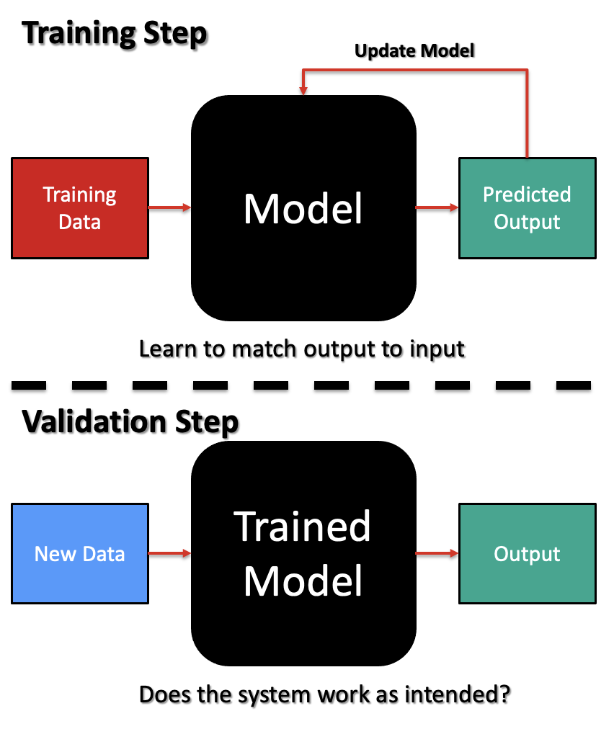
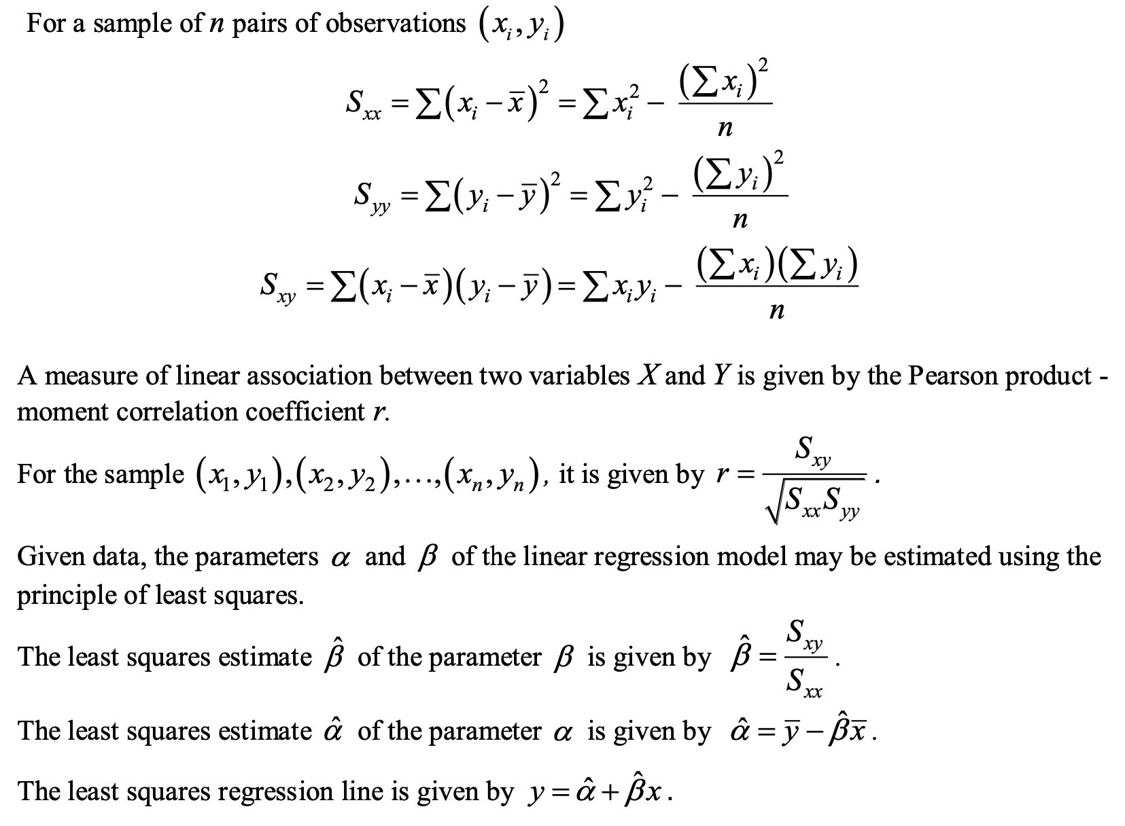
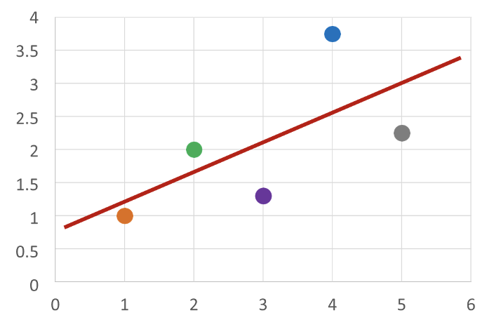
Technologies used
Machine Learning (Supervised Learning) - Forecast desk bookings & allocations.
Supervised Learning: Trained a system to understand a particular problem using subset of existing data, then it can be used to predict new upcoming data.
Application: Regression.
Horizontal-Axis: The distance to cafe/canteen in metres.
Vertical-Axis: The length of joining EY.
Advantage: The prediction can be shown via a “best-fit” regression line.
Notes:
- The first technology I am going to talk about refers to Machine Learning, and precisely Supervised Learning, which can be used to effectively forecast desk bookings and allocations.
- So what is Supervised Learning? Well if you have a look at the diagram on the top right, let’s assume that the Model is a Mathematical function say y = 3x, and assign the training input data to be 2, 3 and 4, then every time we feed those inputs into the model, it will get updated and output 6, 9 and 12 respectively.
- Now this model has got trained and that means if we give it a brand-new piece of data, we can check whether the system works as intended. So 5 outputs 15, 6 outputs 18, and so on.
- In this example, we can use one of the Supervised Learning technique called Regression, which consists of the horizontal axis representing the distance to café/canteen in meters, and the vertical axis representing the length since they first joined EY.
- As we assume that more senior people tend to book more interior places so much less noise and distraction, and for those who newly joined will choose more public working spaces in order to network with more people and get familiarized within the company. We can collect some data by randomly picking 10 people, plot the data point, and draw a line of best fit. The predictions can then be shown by further extrapolating the line.
- The line of best fit can also be obtained by calculation, but I won’t go through them in detail, just for the sake of interest.

Slide 4
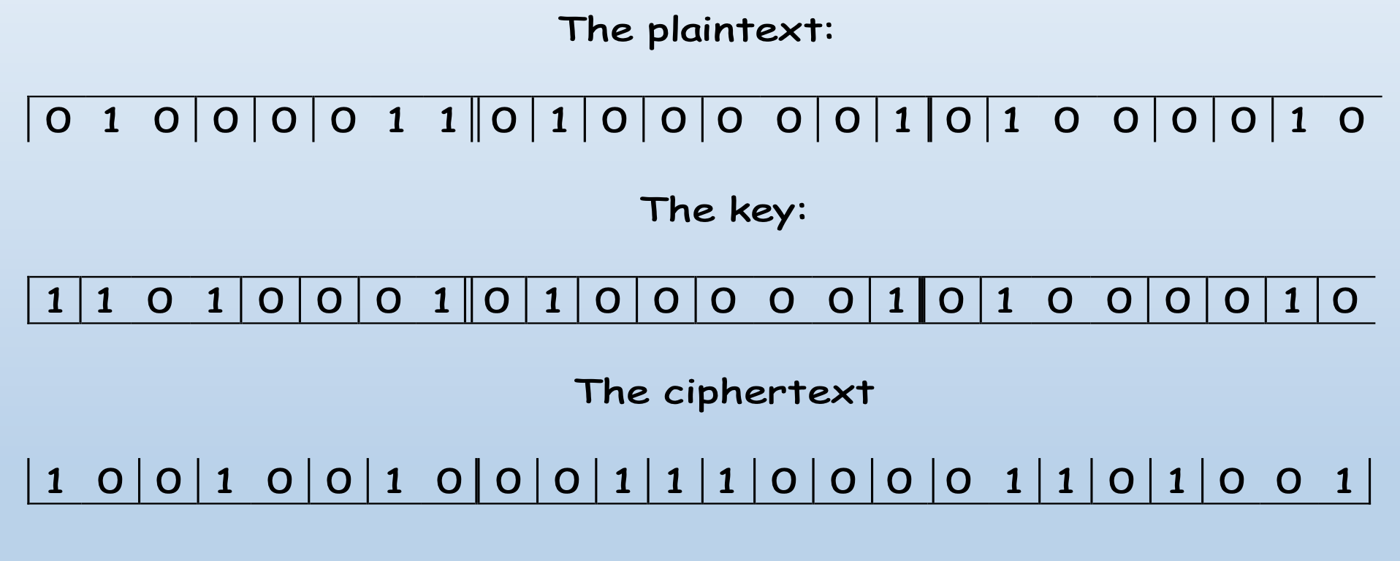
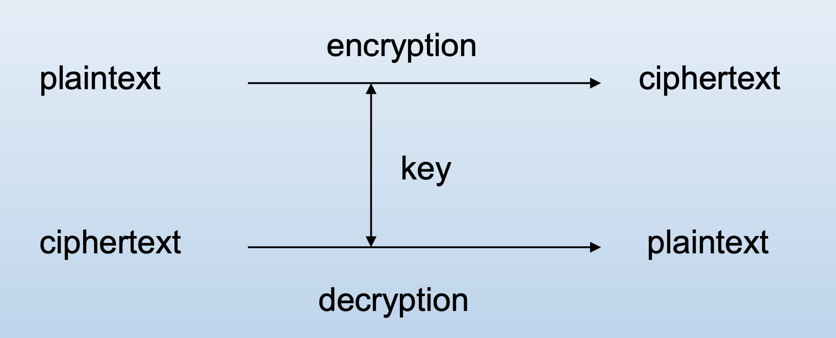
Cyber Security (Cryptography) + Cloud Computing - Securely store personal data.
Cryptography: The enabling technology to ensure that security properties are guaranteed.
Cloud Computing: On-demand availability of computer system resources, especially data storage and computing power, without direct active management by the user.
Application: Encrypt all personal data into a cloud via Symmetric Cryptographic Algorithm.
Using a single key for encryption/decryption.
Ciphertext in the cloud, with the same size as plaintext.
Block Cipher for conversion specifically.
Advantage: Confidentiality, Integrity, Authentication, Nonrepudiation.
Notes:
- The second technology is more like a combination of Cyber Security and Cloud Computing in order to securely store personal data relating to desk bookings.
- For Cryptography, it’s one of the specific part of Cyber Security, which manipulates data for the purpose of hiding and authenticating information.
- For Cloud Computing, it’s an on-demand access, via the internet, to computing resources (applications, servers, development tools etc). This is hosted at a remote data center managed by a cloud services provider (or CSP in short).
- In this case, all personal data can be encrypted into a cloud using Symmetric Cryptographic Algorithm.
- The image at the bottom left is a simple example showing how the plaintext is converted into ciphertext using some encryption function. And the one on the right-hand side gives more intuition. Basically the key here means that the encryption algorithm can be derived from the decryption algorithm and vice versa. The plaintext and the ciphertext both having the same size. And for ciphertext, it’s converted specifically via a Block Cipher, which takes one block of data at a time for each conversion.
- When using these kind of technology, there are four things which get enforced for storing data. The first one is Confidentiality, which ensures that others without the key cannot read the content of the data. The second one is Integrity, which verifies that the data has not been modified. Then for Authentication, it determines where this data has come from, and finally Nonrepudiation ensures that the sender (in this case people who put all the information into the cloud) should not be able to falsely deny that the data was sent.

Slide 5
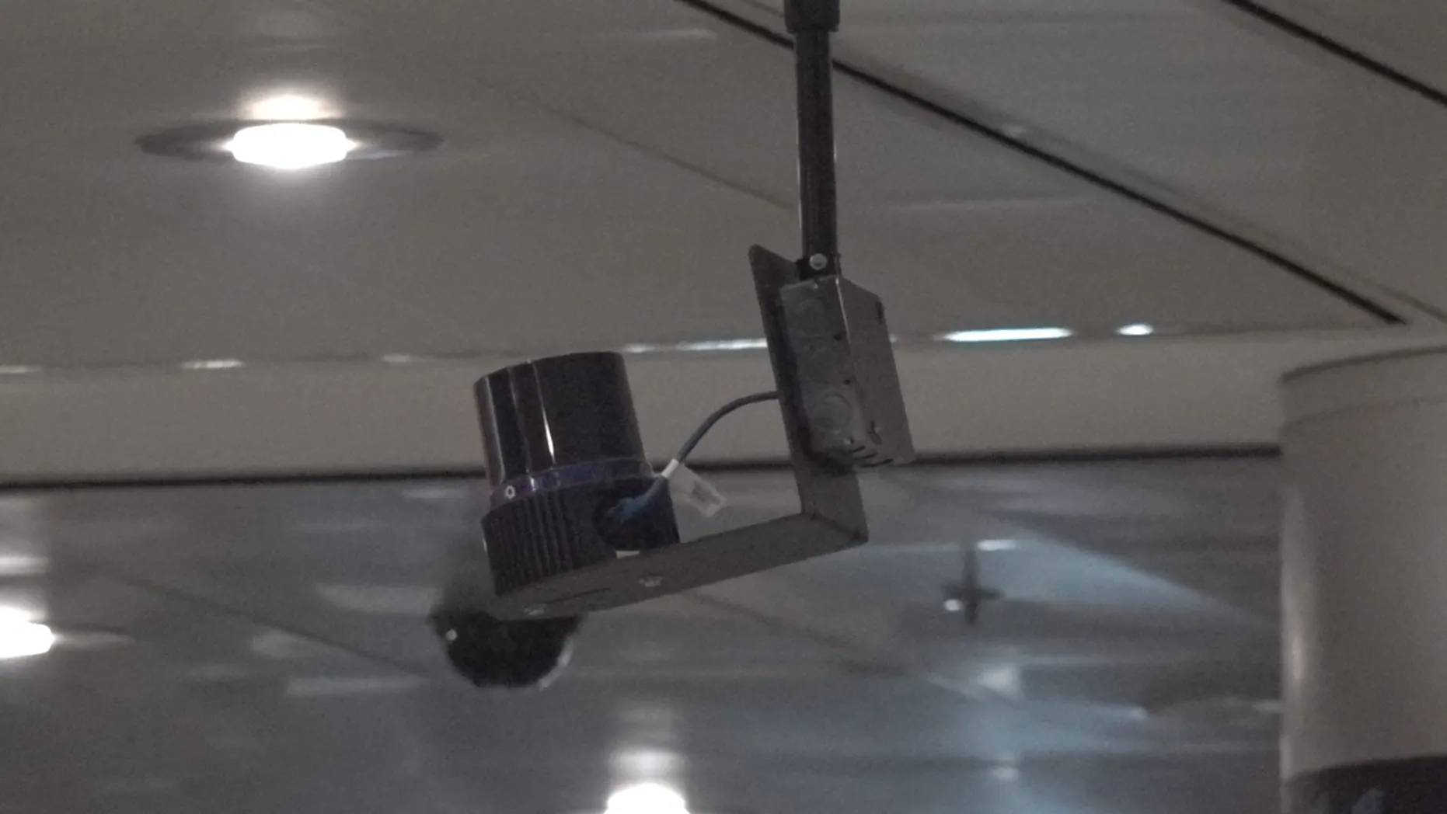
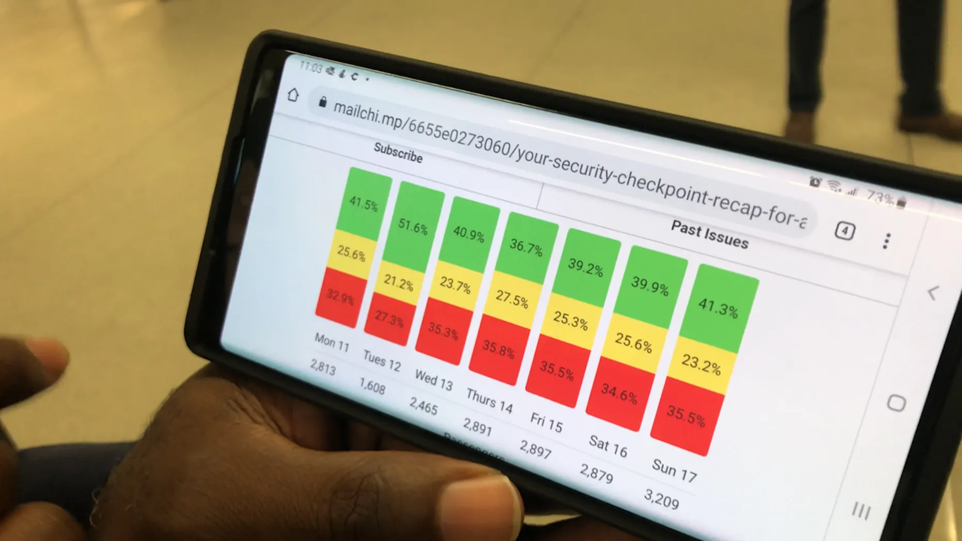
Artificial Intelligence (Model-based) - Monitor Social Distancing.
Model-based AI: Define an encoding of what the world looks like, how we can change that world, and search for good strategies on how to change the world the way we want to.
Application: Video-Based people-tracking software => smart camera.
Treat every single person as a dot and localise them.
Advantage: The social distance measurement can be modelled based on how traffic lights work on the road.
Alarm will get triggered if the “red portion” is above a threshold, can be announcement-based.
Notes:
- The third technology refers to Artificial Intelligence, what I mean in this specific example is the symbolic/classical AI approach, which is a methodology or process derived from a human’s written code, and from that the system can search for good strategies to solve problems within the solutions’ domain.
- Here, I am using a video-based people-tracking software deployed in Miami airport, which I think is also suitable for EY.
- Let’s imagine every person in there is a moving dot. You can get a really good kind of image from above of where everyone is, how they cluster, how they’re moving, how far apart they are from each other, and so on.
- The camera on the ceiling then use the data to generate a “score”. You can see green, red and yellow here, pretty much like a traffic light on the road, and green are the people that were maintaining a social distance of six feet or more. Audio announcements will be generated if too many people are not obeying the social-distancing rules.

Slide 6
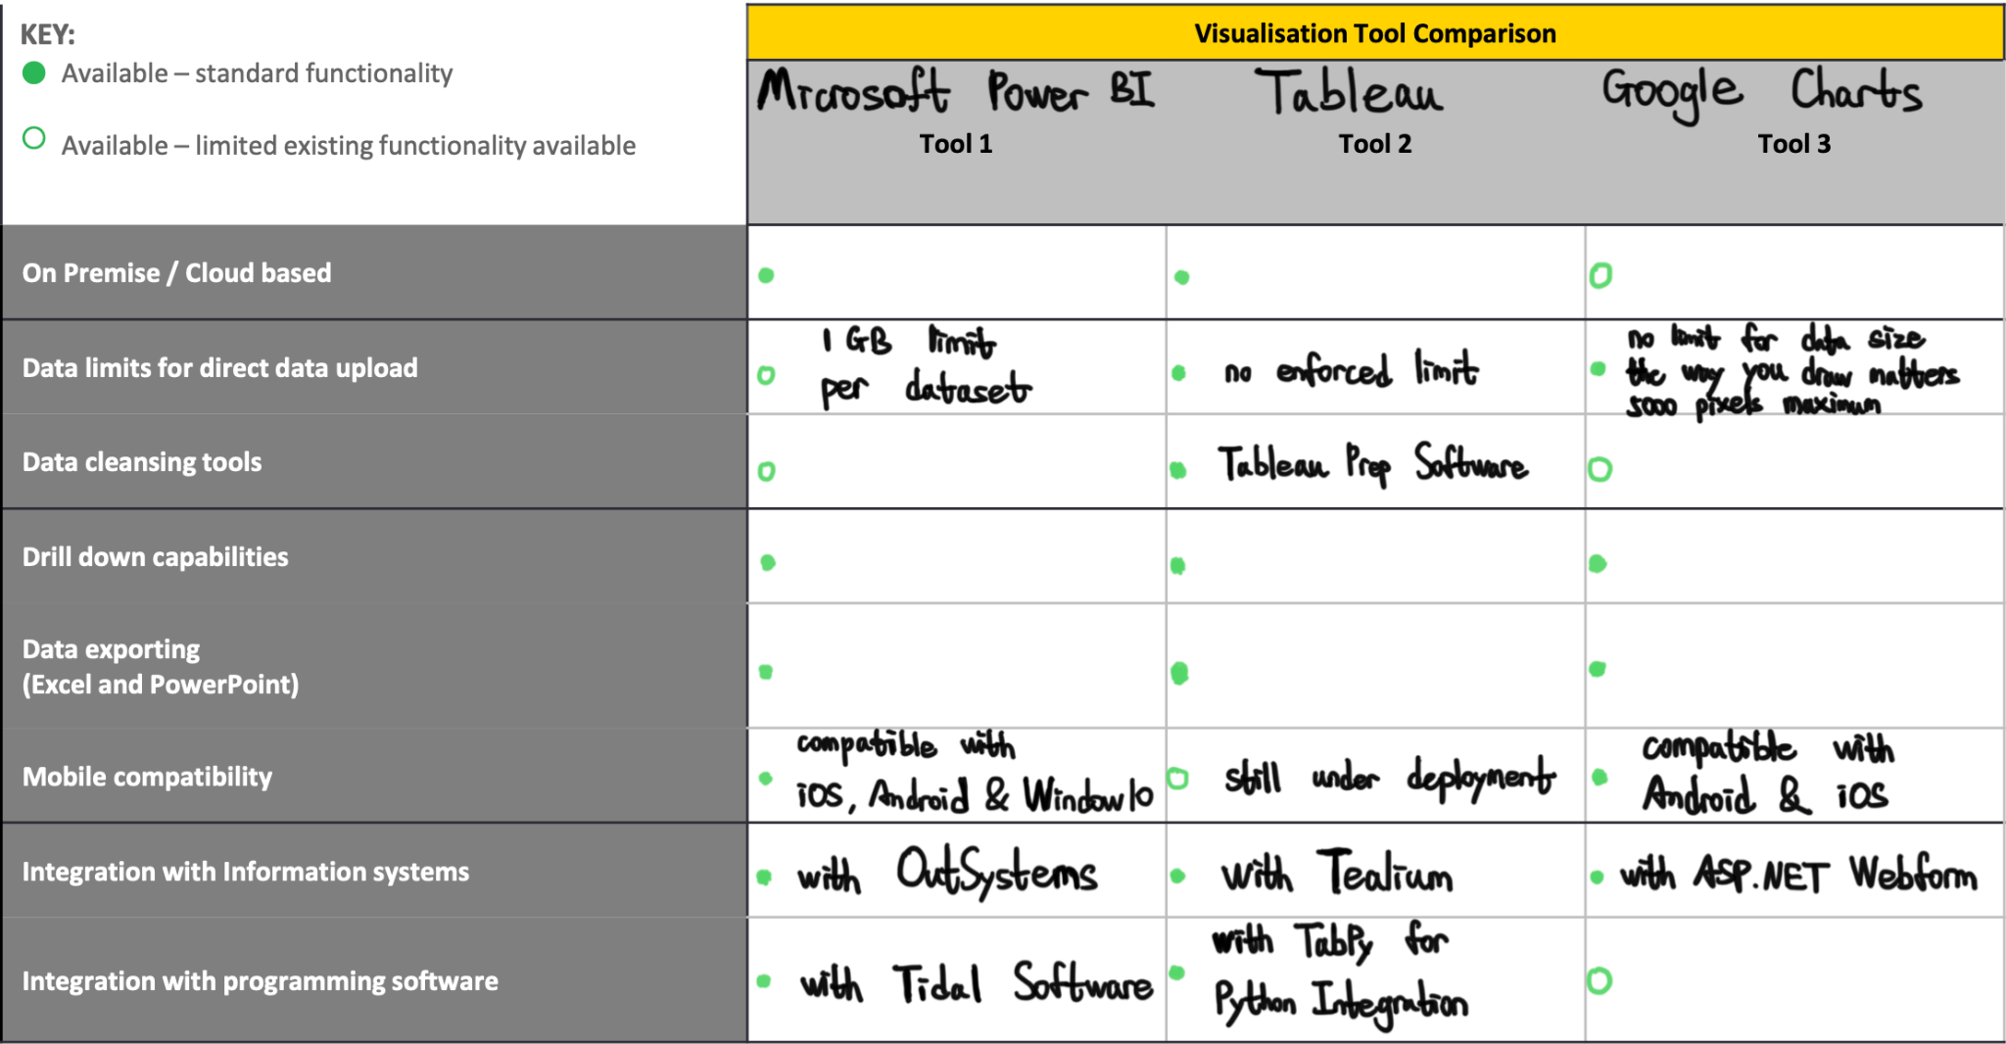
Vendor Comparison
Notes:
- Now moving onto the Visualization Tool comparison for vendor, there are around 20 data visualization tools by quick Googling, and I will pick three of them, which is Microsoft Power BI, Tableau and Google Charts for the sake of this short presentation.
- So let’s compare them by walking through each of their characteristic:
- Firstly, almost all tools are premise/cloud based except for Google Charts.
- Tableau and Google Charts don’t really have limits for direct data upload while there’s 1GB limit per dataset for Microsoft Power BI.
- For data cleansing tools, neither Microsoft Power BI nor Google Charts have one whereas Tableau has a Tableau Prep Software which contains data cleaning functionality.
- And all three tools are capable of drilling down data as well as exporting them to Excel and PowerPoint.
- Regarding mobile compatibility, Microsoft Power BI and Google Charts are both compatible with Android and iOS, while for Tableau is still under deployment.
- They can all be integrated with Information systems, specifically for Microsoft Power BI with OutSystems, Tableau with Tealium and Google Charts with ASP.NET Webform.
- And finally, for integration with programming software, Microsoft Power BI with Tidal Software, Tableau with TabPy for Python Integration, whereas Google Chart doesn’t integrate with any of the programming software.

Slide 7
Summary
Desk bookings and allocations’ prediction.
=> solution: use linear regression: length of joining EY vs distance to cafe/canteen.
=> pro: predict a piece of data via the line of best fit/mathematical calculation.
Secure storage of personal data.
=> solution: use Symmetric Cryptographic Algorithm to encrypt all personal data into a cloud.
=> pro: Confidentiality, Integrity, Authentication, Nonrepudiation.
Using visualisation tools for vendor comparison.
=> solution: use Microsoft Power BI, Tableau and Google Charts.
=> pro: provide quick access to meaningful business insights.
Monitor social distancing.
=> solution: use video-based smart camera to track people.
=> pro: can be monitored using a road traffic light system.
Notes:
- Putting them all together, the solutions of those four objectives mentioned on the second slide has all got clarified.
- So use linear regression to predict desk bookings and allocation, use Symmetric Cryptographic Algorithm in conjunction with Cloud Computing to securely store personal data, use Microsoft Power BI, Tableau and Google Charts as three visualization tools for vendor comparison, and finally use video-based smart camera to monitor social distancing.
In addition to the advantage of three technologies I mentioned earlier on the slides, using visualization tools allows businesses to improve their ability to extract relevant insights from within large datasets, as well as quickly helping them identify relevant patterns and trends hidden in the data.
So are there any risks/costs exist? Yes and that’s what the next slide is going to be.

Slide 8
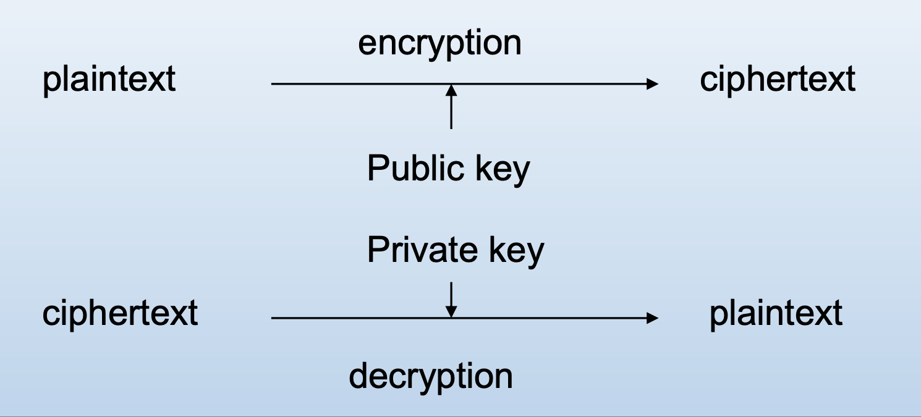
Risks & Issues
Regression for Supervised Learning:
Not very effective if outliers appear. => Try Curvilinear Regression instead.
Cyber Security + Cloud Computing:
Only one key exists so employees can still view the personal information of each other once they access the cloud. => Need a stronger and more secure encryption algorithm: Asymmetric Cryptographic Algorithm.
Smart camera for Model-Based Artificial Intelligence:
Only models individual, not very accurate for family/friend groups.
Using Visualisation Tools:
Lack of understanding of the tools/dataset before using it.
Notes:
- For the first technology, what if there’s some data point lies too far away from the line of best fit? This introduces what we called bias, and the way to fix this, is to try and draw a curve instead of a straight line in order to bring the points closer to the line of best fit, which is called Curvilinear Regression.
- For the second technology, let’s consider a scenario that the managers and every employee have access to the cloud and are able to know where everyone sits within the office. The problem is that some people may not want others to know where he/she exactly is during working hours for the sake of less distraction. That’s when Asymmetric Cryptographic Algorithm comes into place (the diagram pretty much shows how it works), which ensures that everyone can get a distinct private key so that when they log into the cloud, they can only see his/her booking, and the public key can then be handed into more senior team (say the people who monitors the entire reservation process).
- And for the third one, the camera in some cases may misinterpret the social-distancing rules, for instance when a group of people walking close to each other but they’re actually a group of family or friend. This is the problem that the company itself should try to figure it out and do some optimization.
- And the last thing, for using visualization tools, the people using it may not have enough knowledge beforehand regarding business organization, data and their corresponding definition. It generally takes a long time for people who get trained by developing all these skills.

Slide 9
References
Foxnews. 2021. Exclusive look airports embracing an influx of passengers with new social distancing technology. [online] Available at: <https://www.foxnews.com/travel/exclusive-look-airports-embracing-an-influx-of-passengers-with-new-social-distancing-technology>
En.wikipedia.org. 2021. Cloud computing. [online] Available at: <https://en.wikipedia.org/wiki/Cloud_computing>
IBM. 2021. Cloud computing. [online] Available at: <https://www.ibm.com/cloud/learn/cloud-computing>
IBM. 2021. Cryptography concepts. [online] Available at: <https://www.ibm.com/docs/en/i/7.4?topic=cryptography-concepts>
Guru99. 2021. Best data visualisation tools. [online] Available at: <https://www.guru99.com/best-data-visualization-tools.html>
Community.powerbi. 2021. Power BI as a data cleaning tool. [online] Available at: <https://community.powerbi.com/t5/Desktop/Power-BI-as-a-data-cleaning-tool/m-p/682927>
Powerbi.microsoft. 2021. Drill down. [online] Available at: <https://powerbi.microsoft.com/en-us/blog/tag/drill-down/>
Powerusers.microsoft. 2021. Export Power BI data to excel via power automate. [online] Available at: <https://powerusers.microsoft.com/t5/Building-Flows/Export-PowerBI-Data-To-Excel-Via-Power-Automate/td-p/750606>
Docs.microsoft. 2021. Mobile apps for mobile devices. [online] Available at: <https://docs.microsoft.com/en-us/power-bi/consumer/mobile/mobile-apps-for-mobile-devices>
Workato. 2021. Out systems plus Microsoft Power BI. [online] Available at: <https://www.workato.com/integrations/out_systems+microsoft-power-bi>
Notes:
- That’s the end of the video, thanks for watching!

Slide 10
Community.powerbi. 2021. Integrating Tidal Software with Power BI. [online] Available at: <https://community.powerbi.com/t5/Report-Server/Integrating-Tidal-Software-with-Power-BI/m-p/1868018>
Kb.tableau. 2021. Maximum limit for rows or columns of data. [online] Available at: <https://kb.tableau.com/articles/howto/maximum-limit-for-rows-or-columns-of-data>
Tableau. 2021. What is data cleaning. [online] Available at: <https://www.tableau.com/learn/articles/what-is-data-cleaning>
Help.tableau. 2021. Admin mobile intro. [online] Available at: <https://help.tableau.com/current/mobile/mobile-admin/en-us/admin_mobile_intro.htm>
Tealium. 2021. Tableau. [online] Available at: <https://tealium.com/integrations/tableau_tableau.php>
Tableau. 2021. Data science integration. [online] Available at: <https://www.tableau.com/developer/data-science-integration>
Stackoverflow. 2021. Google Charts input data size limit. [online] Available at: <https://stackoverflow.com/questions/29960524/google-charts-input-data-size-limit>
Groups.google. 2021. Google Visualisation API. [online] Available at: <https://groups.google.com/g/google-visualization-api/c/5bnCXUms7jo/m/x-6VJ_7VVC4J?pli=1>
C-Sharpcorner. 2021. ASP.NET Webform Google Charts API integration. [online] Available at: <https://www.c-sharpcorner.com/article/asp-net-webform-google-charts-api-integration/>
Upgrad. 2021. Benefits of data visualisation. [online] Available at: <https://www.upgrad.com/blog/benefits-of-data-visualization/>
Jisc. 2021. Potential risks related to data visualisation. [online] Available at: <https://www.jisc.ac.uk/guides/data-visualisation/potential-risks-related-to-data-visualisation>

